Slide 1



Package Specifications
Tim smith
Fiona Schwallie

Slide 2
Summary
This week, we look at package specifications. With this, we will learn and discover what are package data types and

Slide 3
Package data types
A data type is a classification that specifies which type of value a variable has and what type of mathematical, relational or logical operations can be applied to it without causing an error.
The data type defines which operations can safely be performed to create, transform and use the variable in another computation.

Slide 4
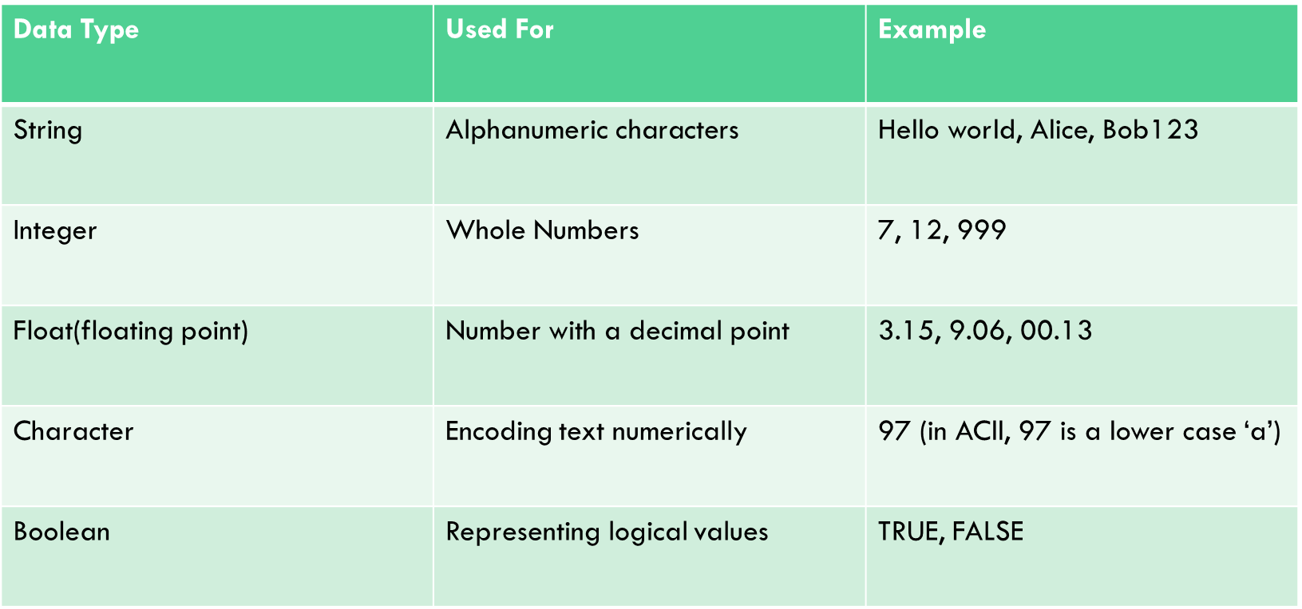
Package Data types continued

Slide 7
References
https://www.techtarget.com/searchapparchitecture/definition/data-type

Slide 8

Thank you
Tim smith
Fiona Schwallie

